Slide 1
Lecture 5 Effective Presentation Skills II

Slide 2
Key Points to be Covered
Planning a Presentation
Structuring a Presentation
Effective Delivery
Presentation Techniques
Effective Visual Aids
Contemporary Relevance

Slide 3
Resources to be consulted for further reading
Chaturvedi. P.D ( 2011). Business Communication: Concepts, Cases, and Applications, Second edition, Pearson Education India.
Its online availability site :https://docs.google.com/viewer?a=v&pid=sites&srcid=ZGVmYXVsdGRvbWFpbnxvbGVya2RyZXN8Z3g6MjU4MTc4NTNmMTdjMWVjNg
Rizvi, A. R. ( 2018) ‘Effective Technical Communication’ 2nd edition, McGraw Hill Education Private Limited, Chennai.

Slide 4
Planning a Presentation
Thinking things through and planning well makes all the difference between success and failure while delivering a presentation
Know what is expected of you
Identify the audience ( Demographics: Age/ Gender/Occupation)
Assess the size of the Audience & Room Layout
Assess the audience’s knowledge of the subject
Assess the attitude( Interest/ Motivation) of the audience
Gather material with enough facts and figures to strengthen your presentation
Audio- Visual Aids

Slide 5
Structuring the Presentation
Men perish because they cannot join the beginning with the end.’
Tip:The former Conservative Prime Minister, Harold MacMillan was advised by David Llyod George, the Welsh Wizard, renowned for his oratory that he should make one clear point in his speech. In other words, the fewer points one makes, the better the chance that the message would be remembered.
Some ways to structure a presentation:
Topical( Different Aspects of a subject covered one by one)
Chronological
Problem-Solution Structure ( likely to produce a persuasive speech)
Cause Effect

Slide 6
Opening a Presentation ( The Introduction)
Seize the attention of the audience and amuse them at the same time by saying or doing something in character with the occasion.
Invite direct Audience Involvement through questions
Surprise the audience with startling statistics and challenge their assumptions.
Call the audience to attention, greet them and remind them why they are gathered together
Use humor to get their attention
Use Anecdotes/ stories to create interest

Slide 7
Body of Presentation
As you take your audience on a journey, you need to signpost the route…
Start with telling them the areas you will be covering
While speaking, one needs to spell things out more clearly
Plot use of humor at intervals- to revive the audience’s attention
Keep anecdotes pithy and to the point
Surprise the audience by asking direct questions and in addition ask for a show of hands
Get listeners to write/ jot down things through interaction methods
Be careful with criticism and controversy
Appeal to the instinct to explore new ideas

Slide 8
The Conclusion
Conclusion needs to be memorable as this what the audience hears last and it stays uppermost in their minds.
Keep a few tips in mind
Don’t introduce new points in the conclusion
Reiterate in strong, memorable words and phrases the thrust of the whole presentation/ speech
Use an apt quote/ humor/anecdote
Leave the audience thinking with a question, which can be answered later through mail

Slide 9
Effective Delivery-I
Apart from speaking impromptu, which is not advisable except for very accomplished speakers, three ways of delivering a presentation include
Carrying content and structure in one’s head ( most preferred by audience)
Using notes ( size of postcards, especially if one wants to jot down statistics, quotations and key words.)
Reading from a script ( Politicians often speak from scripts as it acts as a safeguard against slip of tongue during speeches which are reported in press or broadcast)

Slide 10
Effective Delivery-II
Rehearsing: Once the speech is structured ,rehearsing is the key.
A few questions to assess the presentation ( Rehearse stage)
Try out and practice the speech with friends, colleagues or relatives, choosing the ones who will give constructive criticism
Ask them if they could identify with the main thrust of the speech and seek their thoughts on the delivery of contents
Take feedback on the use of voice and body language
Get them to ask questions at the end of the presentation
Check for timing( It is advisable to finish before time)
If visual aids are being used, rehearse with them

Slide 11
Effective Delivery-III
Using the right language, rhetorical tricks, gestures, vocal techniques---varying in pace when one delivers a presentation are important aspects of Effective Delivery
Short sentences and simple language ( Short sentences convey points precisely)
Rhetorical tricks: (The effectiveness of the use of repetition, contrast particularly at the beginning and end of presentation)
The use of Gesture ( to emphasize and stimulate the attention of the audience)
Clear Speech ( Articulation is the key)
…continued

Slide 12
Effective Delivery-III
The use of Pause ( before particularly important statements, statistics, anecdotes, quotations helps create momentary suspense. They give one time to take breath, organize thought and audience time to assimilate what has been said)
Variety of Pace, Pitch & Volume ( Avoid monotonous tone; vary how fast and loud you speak; don’t gabble; assess yourself critically when you practice)
Eye Contact ( Steady eye contact inspires confidence)

Slide 13
Taking Questions
Question time helps to build and amplify what has TO be presented…
Open to Answering Questions: At the outset communicate it to the audience
Anticipate: Ten most likely questions and have answers planned for them
Understand the Question: paraphrase if necessary
Occasionally someone will ask a question that is not a question at all, rather an expression of their point of view. Quietly restate the case and move to the next question
Sometimes one cannot answer the question---be honest but at the same time offer to search for it and communicate at a later date.
When discretion prevents one from answering a question , stall by being honest

Slide 14
Using Visual Aids
The ancient Chinese proverb states “A picture is worth a thousand words”
Pictures & other visual aids like PowerPoint Slides, Graphs, Charts, Films, Video, Maps, Models, Sketches----certainly do make an impact but they seldom replace words altogether
Visual Aids help to
Enhance Understanding
Enliven the message
Add Variety
Inspire and engage Audience
Visual aids enable a speaker to communicate information more quickly and listeners to absorb it more readily. A simple formula emerges…
Words+ Visual Aids=Quick Comprehension+ Long lasting impression
Used Poorly--- A Distraction--- Ineffective Presentation

Slide 15
Do’s & Don’ts of Visual Aids
Limit the number of visual aids
Don’t cram too much information into any one visual aid
Rehearse with visual aids
Face the audience while using visual aids
Don’t stand in front of visual aids
Be specific with what you are indicating

Slide 16
Acing the Presentation
Be yourself!
Maintain Eye contact with the audience
Practice thoroughly
Present with conviction/sincerity; enthusiasm; power of speech; simplicity
Fight the fear
Fight the common problems of verbal fillers, swaying, rocking, fidgeting and failing to be audience-centered

Slide 17
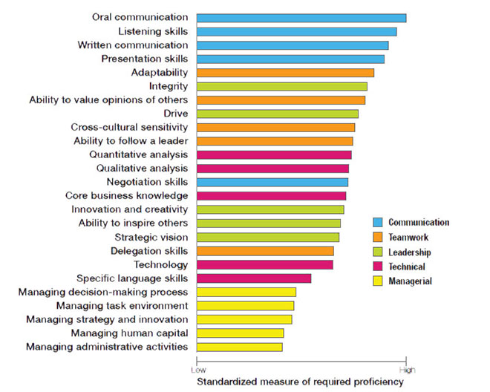
Contemporary Thought Building Public Speaking Skills

Slide 18
Contemporary Relevance
If you manage to overcome your fear of public speaking, this is a brilliant skill for your resume and you’ll be able to accelerate more quickly in your career, as well as be more confident in your personal life. The core of being a great public speaker lies predominantly in one thing: confidence.
Oral communication skills, listening skills, written communication and presentation skills are among the most in-demand skills for employers. Communication skills have become essential to advancing your career and improving future opportunities in life and the workplace.
Source: https://virtualspeech.com/blog/what-is-glossophobia-and-how-to-overcome-it

Slide 19
Learning Outcomes
Planning and structuring good presentations
Ability to deliver presentations and handle questions with confidence
Effective use of Visual Aids
Contemporary Relevance of Presentation Skills

Slide 20
References
https://virtualspeech.com/blog/overcome-fear-public-speaking-guide-tips
https://virtualspeech.com/blog/what-is-glossophobia-and-how-to-overcome-it
Kahn, Jarett, et al, ”How to write and speak better”, The Reader’s Digest Association Limited by Toucan Books Limited in association with Wordcraft Editing & Writing Limited, 1993

Slide 21
Questions…
Answer True of False: ( OBJECTIVE)
It is preferable not to invite direct Audience Involvement while making a presentation.
Don’t say how nervous you are – try not to complain to others about how anxious you feel.
Introducing new points in the conclusion makes it more interesting.
Subjective Type (Answer…Next Slide)
Identify some ways to handle someone who challenges or irritates you after you have delivered a presentation?
You yourself are your most effective visual aid. Discuss

Slide 22
AnswerS…
Subjective Answer (1)
Don’t let your face or body language show that you feel threatened.
Keep an open posture and answer calmly
If the challenger persists with his arguments, suggest that they discuss the topic at another time as it would be inappropriate to enter into a private dialogue while the others are present too
Break eye contact, turn to another part of the audience, and ask for another question
Answer (2)
Visual Aids are only aids…what you say and how you say is more important
Audiences respond not only to your words but to you. IT PAYS TO Look alert, upright, self-assured.
IN OTHER WORDS, If your appearance inspires confidence, people will listen to you with interest and enthusiasm

